Slide 1
From Data to Dashboard
Alexander Baker

Slide 2
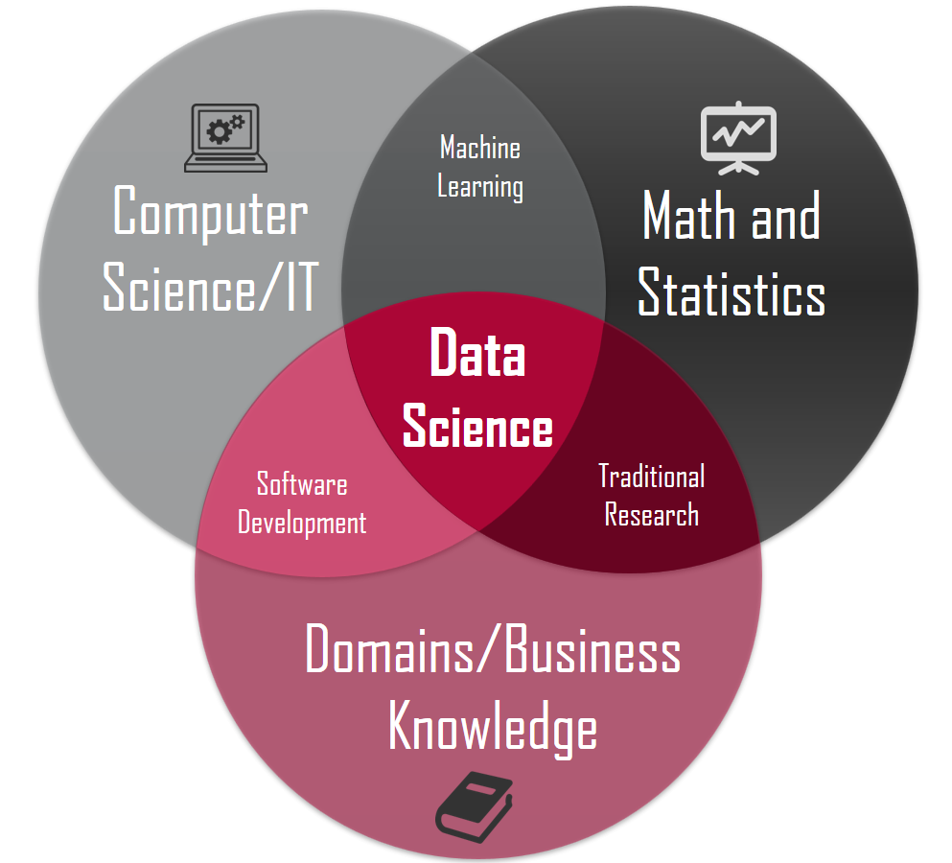
Data Science
Data science is the intersection of statistics/mathematics, computer science, and domain knowledge to gain insights from obtained information
This field of study typically employ artificial intelligence to assist with the ability to gain insights
There are many similar roles to data scientists that require many of the same necessary skills and responsibilities
Data scientist - Use advanced algorithms to solve open ended and vague problems
Data analyst - Use structured data to solve tangible business problems
Machine learning engineer - Researches, builds, and designs machine learning models and algorithms
Data engineer - Develops, constructs, and maintains advanced data architectures and pipelines

Slide 3

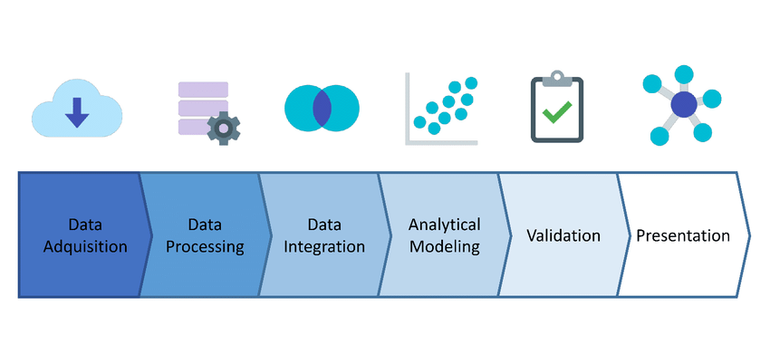
Data Science Pipeline Overview
What problem are you trying to solve?
What data do I need to solve it?
What do I have to understand about the context of this data?
What do I need to understand about the data internally?
Which features can potentially be useful based on the context and internal trends of the data?
Which algorithms would perform the best?
How do our algorithms perform?
What is the best way a user can interact with the model?

Slide 4

Problem
This is the most important step of the whole process
It’s first important to understand what problem you want to solve
What is the overall goal of the project?
Do you care about performance or analytical capabilities?
What metrics is particularly of interest?
How do you quantify that metric, and what system is it a part of?
It’s important to ensure your analysis will provide the intended value

Slide 5
Data
Search for a set or sets that will assist in solving your problem
Keep your problem in mind as you look into various datasets
Here are some resources to get your started
Kaggle
Data.gov
Drivendata
UC Irvine Machine Learning Repository
Google Public Data Explorer
There are some sites that specialize in data for your specific domain i.e. Global Health Observatory Repository for health data or the UN’s data repository for human rights data.

Slide 6
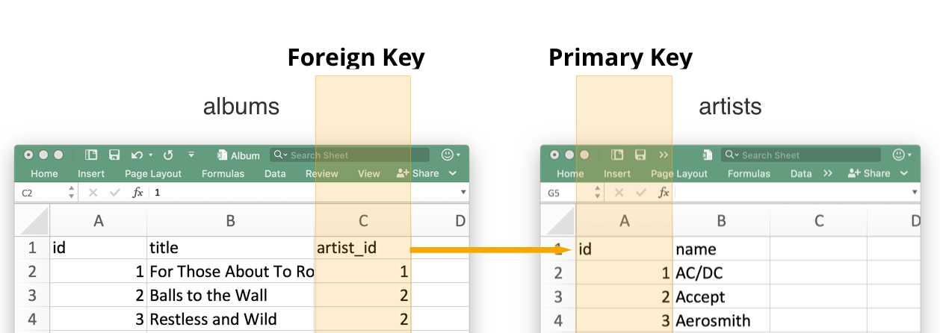
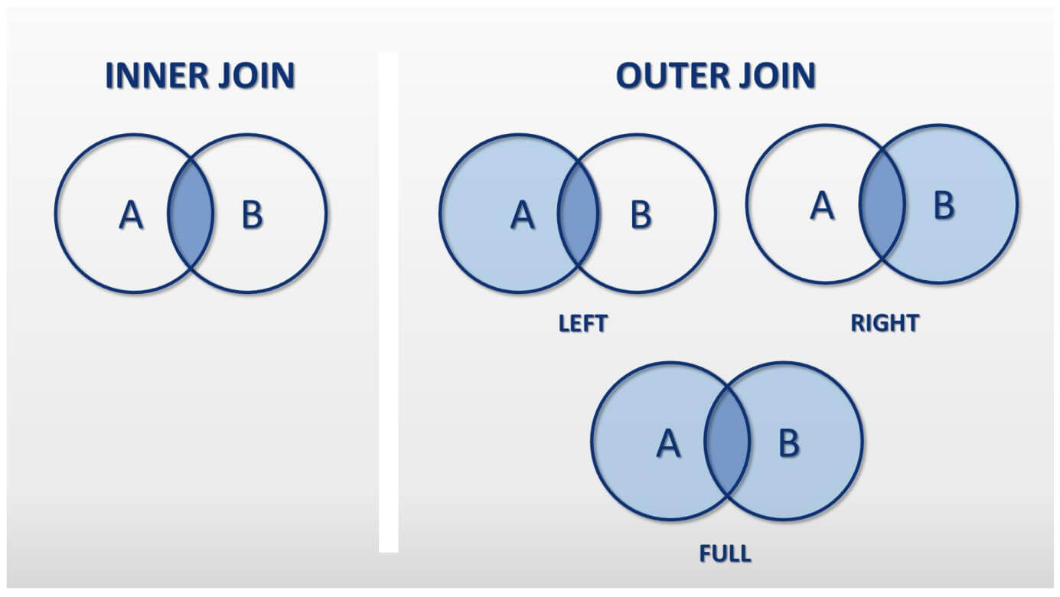
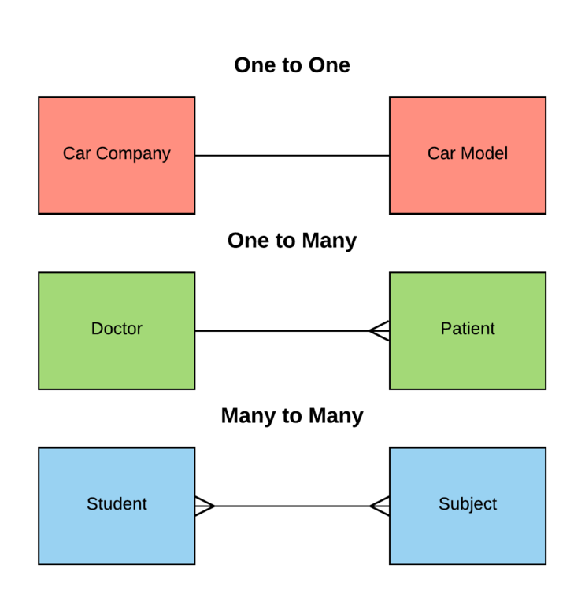
Some Data Tips
Always keep an eye on what is called the primary key of your data
This is a unique identifier that refers to each unique entity in our dataset
Also keep an eye out for possible foriegn keys
These are fields that identify other entities within the same dataset, and serve as the primary key for a different dataset
This allows a potential connection between two data sets
Inner join, outer join, left join right join
One to many, many to one, many to many,
It is important to watch for many to many relationships when combining datasets, and amend them
This is when a relationship between two entities have too many potential connections for clarity
I.e. classes have many students and students take many classes, it’s important to have a class to student relationship table to connect these two sets

Slide 7

Context
Domain knowledge is important for understanding your dataset adequately
This can give you the proper knowledge, of feature engineering, potential confounding variables, and so on
Here are some questions you can ask:
When was the data collected?
Where was it acquired?
What are the basics about your data’s subject?
What would a field expert consider useful or not?
What do the columns mean, and what are the categories/numbers/levels?
What are the logical values for each column?
This is nowhere near the end,but it can give you a good start

Slide 8

Exploration
Now it’s time to jump into the data itself
It’s important to first take a look at your output variable
What are the categories?
How different are the category frequencies?
How does this output variable relate to other fields?
Do I have potential confounding variables?
Look at the relationship between your input fields:
Which fields could potentially be redundant?
Are there some potential relationships between the fields?
What are some of our field distributions?
With these findings we can start to preprocess our data for modeling

Slide 9

Feature Engineering
An incredibly important part of data science
Thankfully we have been building to this step
First, let’s build our new features
Using the domain expertise, and our exploration we can make some new useful features:
Can we combine columns to make something more useful?
Will converting the field’s data type be more helpful?
Can we incorporate additional information from a different dataset or database?
Can we change the values of a field using outside scripts or software?
How do our new features relate to the rest of the fields?

Slide 10
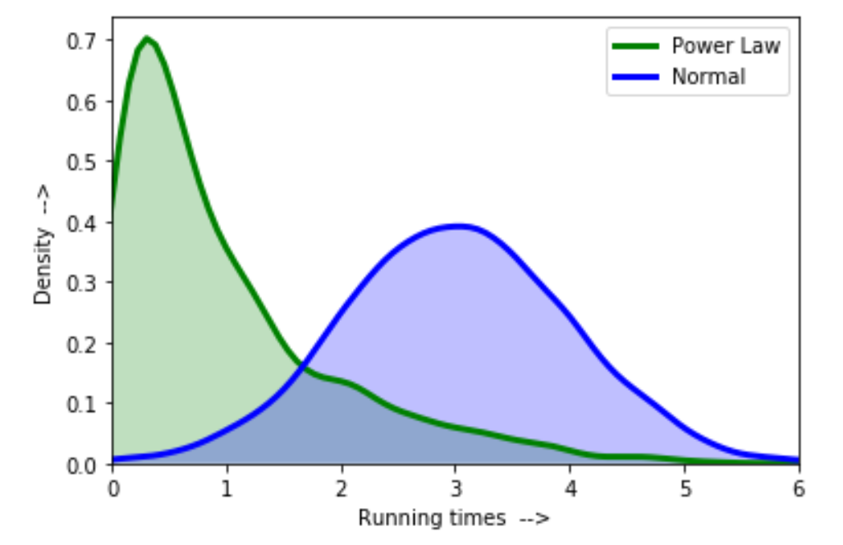
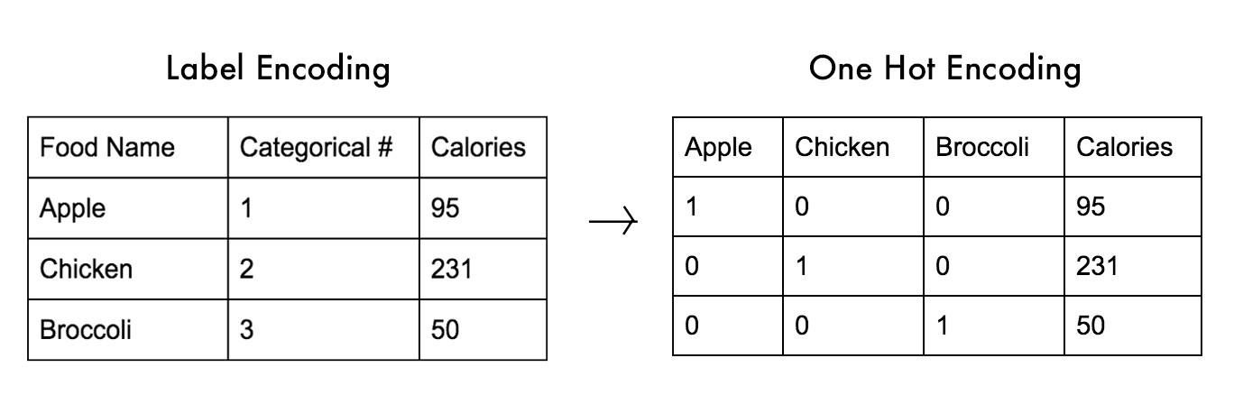
Preprocessing
Now that we have our fields, we have to prepare our dataset for modeling
Play with distributions of certain numerical fields if they are non-normal
Will your model be better on an aggregated dataset?
Modeling modeling methods are unable to handle categorical data:
One Hot Encoding makes each category a true or false column, and is best for categorical columns without an order
Label Encoders turn a categorical column into a column of integers representing each category, and is best for categorical columns with order
Drop columns you may not need to avoid overfitting
Drop redundant columns
Can use Principal Component Analysis to reduce columns based on variance
Can use step models to eliminate features based on the perceived effect they will have on the output

Slide 11
Modeling
Finally we arrive at the machine learning portion of data science
Machine learning produces an output with various methods,finds the error, then uses this to adjust and improve your model, and repeats
This process iterates until convergence, or a different piece of criteria is met
Some ML Methods include:
Logistic Regression - linear model that fits optimal coefficients to predict an outcome
Decision Tree - singular tree based model that uses optimal splitting
Random Forest - ensemble model of bootstrapped decision trees
Gradient Boosting - ensemble model where bootstrapped submodels (usually trees) that are improved with the error of the previous submodel (this occurs within the same iteration)
Support Vector Machines - data is separated on a hyperplane with a given function

Slide 12
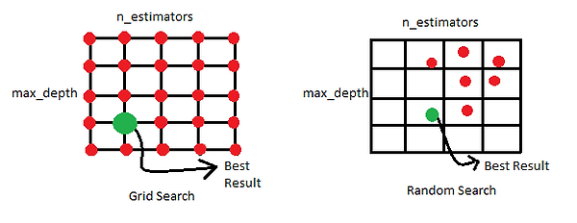
Optimization
Now we have to squeeze the last points of accuracy (or other metrics) from our model
Grid searching is the method of evaluating all possible sets of parameters within a given range to find the best combination
It’s important to perform research on the various parameters of your model, and what they do
Grid searching can take a long time, there are parameter optimization algorithms that can execute with a shorter run time
Bayesian
Random Search

Slide 13
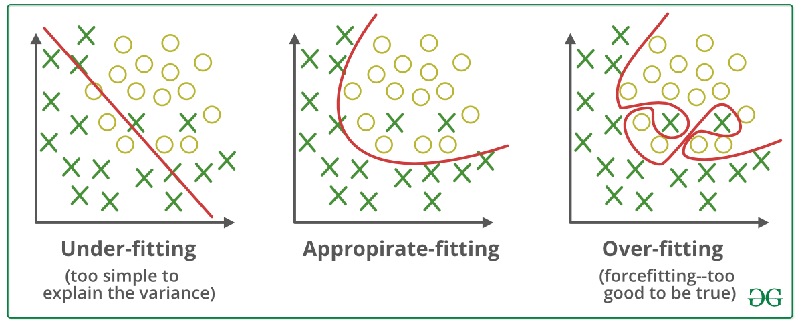
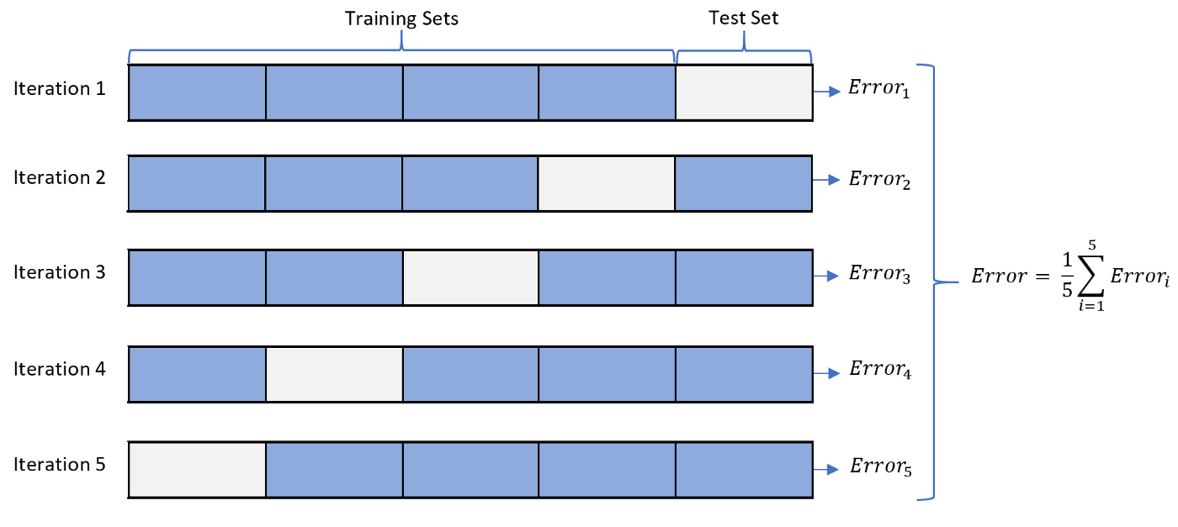
Evaluation and Validation
Prior to training set aside a piece of data as your validation set
This will simulate prediction with inputs foriegn to the model training
Check that your model’s predictions are reliable
Overfitting - model is overtrained, performs well in training, but doesn’t perform well in production
Underfitting - model undertrained, does not perform well either in training nor production
There are numerous metrics that can be useful for evaluation
Accuracy
Precision
Recall
F1 Score
ROC Curve
Evaluation is more than accuracy
Once you select your evaluation metric, use cross validation to further evaluate
Cross validation is the method in which the data is divided into a number of pieces, a piece of the data is selected as the testing set and the rest of the pieces are used for training.
Each piece rotates as a test set, and the final evaluation metric is calculated

Slide 14
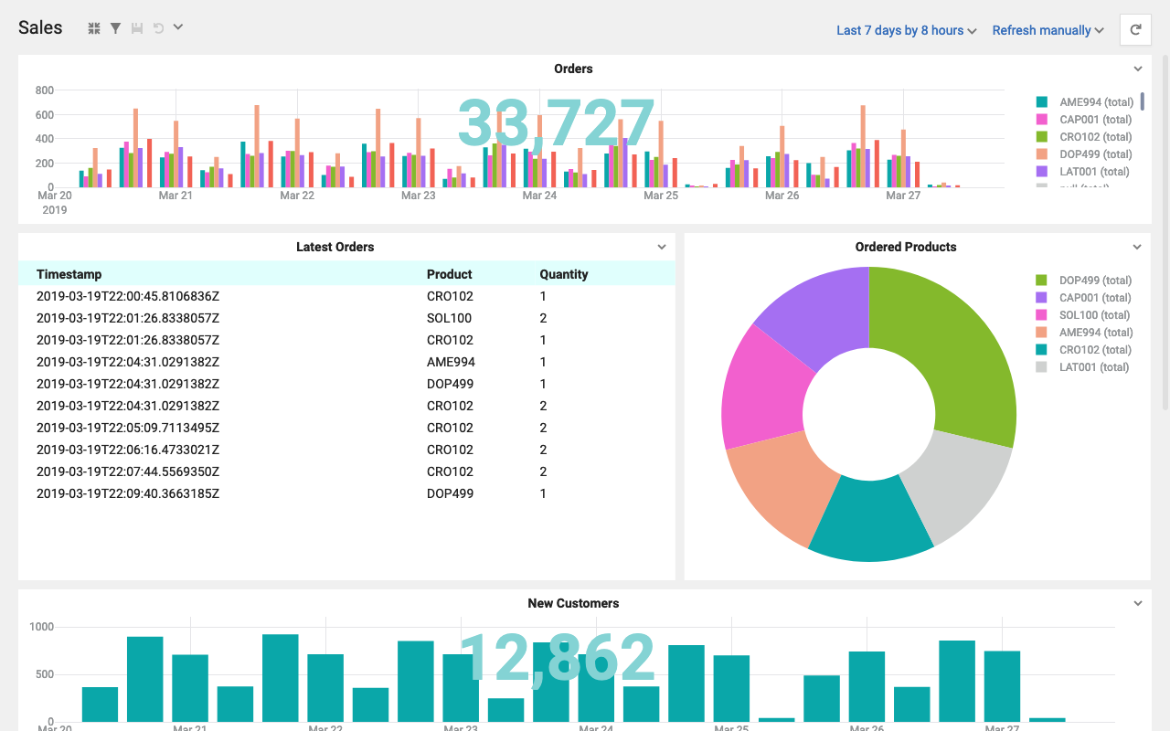
Dashboarding
Use pickling to transport your model to your dashboard
Now let’s make our model interactive
This will give your portfolio an edge
Find which library would be best:
Do you need a deep drill down
Is a faster more convenient library needed
Maybe one library in between
Which widgets would best allow the user to interact with the data
How can you form inputs for your model
Some libraries include
Flask
Streamlit
Dash

Slide 15
Conclusion
In this talk, your learned the entire data science pipeline
The general steps:
Problem
Domain knowledge
Dataset formation
Data exploration
Feature engineering
Preprocessing
Modeling
Optimization
Evaluation and validation
Dashboarding
These steps can be repeated, cycled through, and completed out of order
This is just a general pipeline to set the groundwork

Slide 16

Next Steps
Deep Learning
Natural Language Processing
Image Processing
Audio Processing
Reinforcement Learning

